Slide 1

Good Afternoon and Welcome

Slide 2

John Kelly
Investigator Saratoga Springs PD (Ret)
Forensic Interviewer of Children/NCAC/Child First/FIBP
Statewide MDT Director for NYS Childrens Alliance
Former Safe Harbour Coordinator for Saratoga County
Former National Center for Missing & Exploited Children

Slide 3
Disclaimer
The views and opinions expressed during this presentation are those of the presenter and may not necessarily reflect the policy and position of NYSCA

Slide 4



Human
Trafficking in and around NYS

Slide 5
Solving an Epidemic: Human Trafficking in America
Human Trafficking: A Growing Epidemic - Nurse.com
Human trafficking a sickening US epidemic - Hannibal Courier ...
Human Trafficking Is an Epidemic in the US- Bighttps://fortune.com
Apr 14, 2019 — Nearly 9,000 cases in the U.S. were reported to the National Human Trafficking Hotline and BeFree Textline in 2017—a 13% increase from the prior ...

Slide 6
New York State allocates nearly $2.4 million annually to the Response to Human Trafficking Program, which provides case management and referral services to confirmed human trafficking victims throughout the state. ... There were 288 victims of human trafficking confirmed in 2019 alone.

Slide 7

IMHO
the more data you look up - the more confused you will be
unfortunately $$ is connected to data

Slide 8

bottom line
WE need to look at OUR community resources and determine how to address trafficking of ALL individuals
Every community has trafficking

Slide 9
Two Types of Trafficking
  Labor
  Sex

Slide 10

How do we identify trafficking victims

Slide 11
Intentional
calling hotline
calling/meeting with provider
connecting with street outreach
Unintentional
hospital visit
sting operation
family reaches out

Slide 12

SAFE HARBOUR

Slide 13
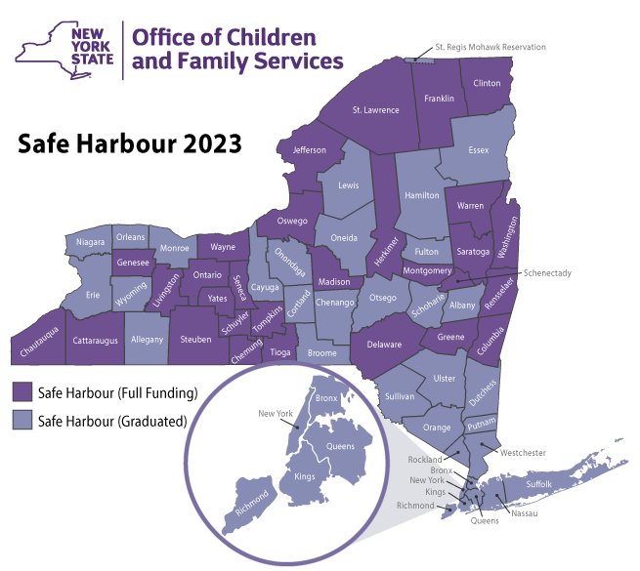

Slide 14
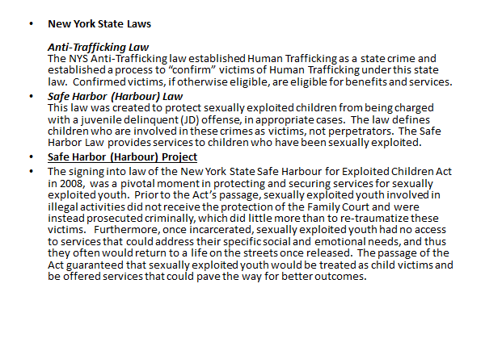

Slide 15
Safe Harbour NY: is a program that implements a system-level approach within existing child welfare and allied youth-serving systems, including Runaway-Homeless Youth programs (RHY), Probation, Persons In Need of Supervision (PINS), Youth Bureaus, and other critical partners. This approach leverages existing system strengths to create a more effective and efficient response to youth who have experienced commercial sexual exploitation or trafficking,
or who are vulnerable to it.

Slide 16
An example of NGO's that can assist in trafficking cases
  Designated Safe Harbour coordinator/OCFS
  RHY facility or services provider
  Victim Advocacy Agency/CAC/DV services
  Salvation Army
  Religious organization with community outreach
  Hospital ER or Urgent Care facilities

Slide 17
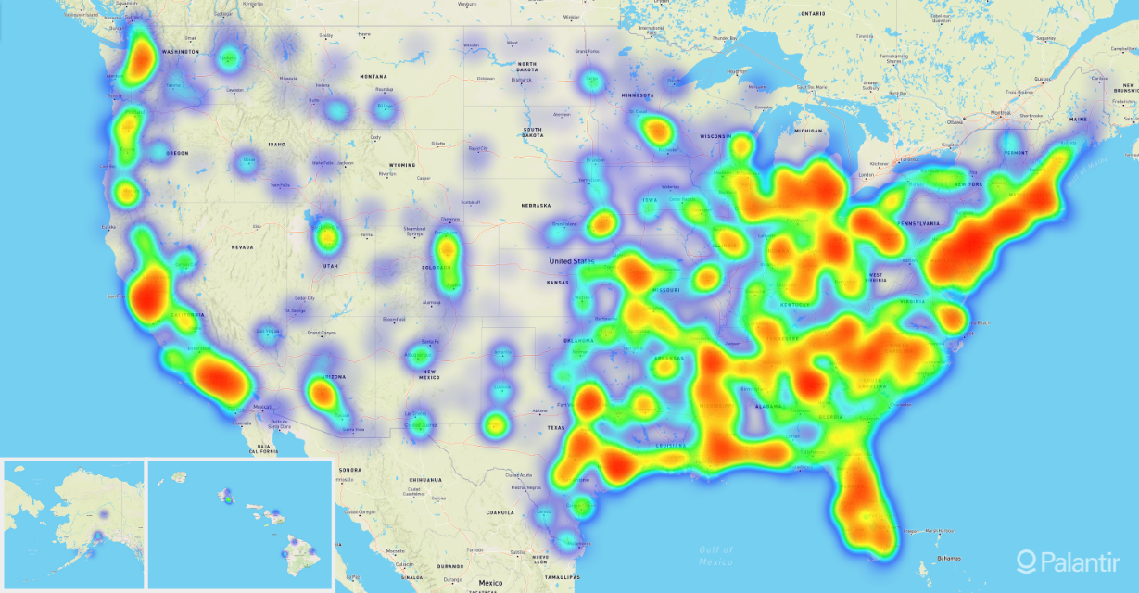


Slide 18

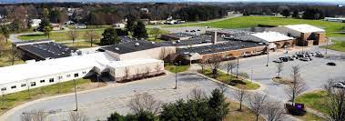
2471 Students
preK-12

Slide 19
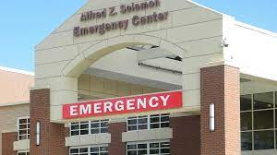

Slide 20
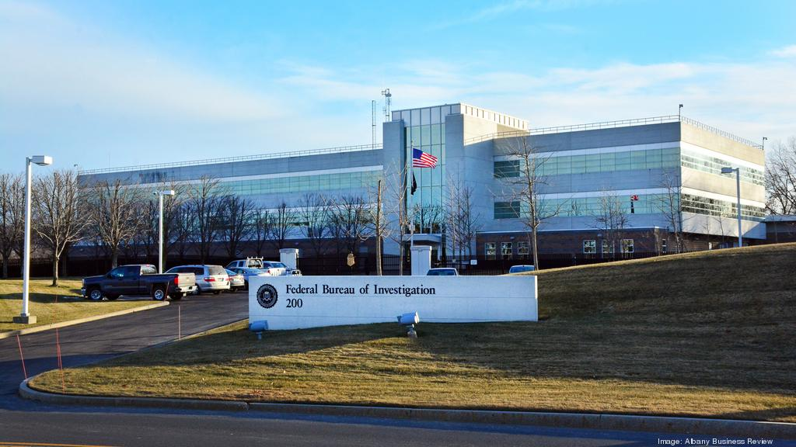
meets with agent Fallon and advocate
information to be shared with the Task Force

Slide 21
trafficked around the Capital region
60/40 split with Rodriguez
acted as "bottom" when needed x1
multiple ads online not controlled by victim
could bring in up to $1000 per week
weekdays good for business travelers

Slide 22
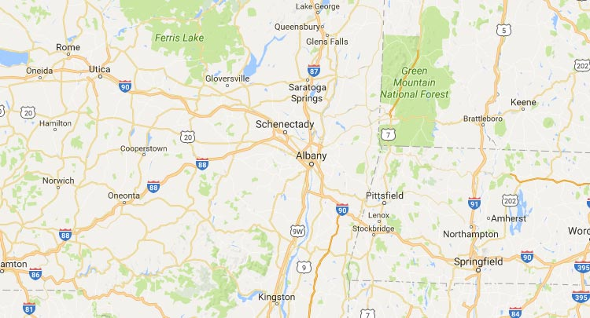



Slide 23

Jurisdictions
Washington County NY (School & Childhood Home)
Ulster County NY (Court & Trafficking)
Saratoga County NY (Hospital & Safe Harbour)
Rensselaer County NY (Pimp)
Warren County NY (Court & Sister)
Charleston SC (Fed Court & Trafficking)

Slide 24

Safe Harbour Funds
  Bedding at sisters home
  Tattoo cover up
  Medical follow up-STI meds
  TFCBT co-pays
  New clothes/gift cards

Slide 25

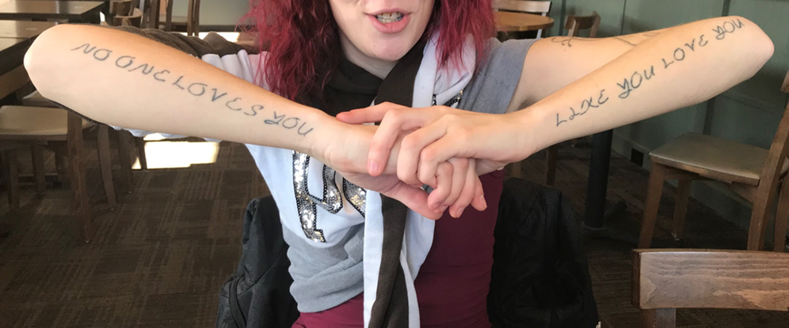
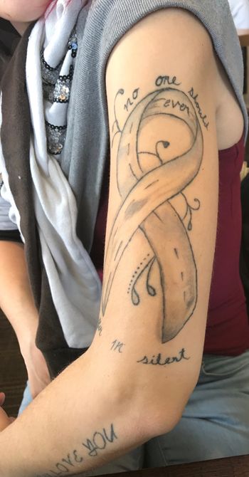
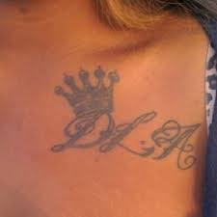
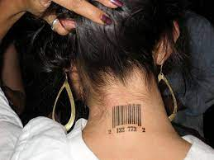

Slide 26
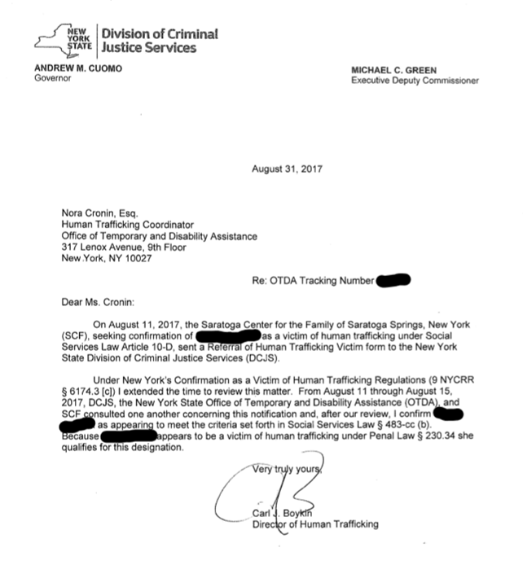

Slide 27
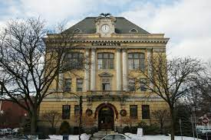
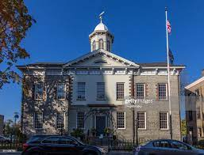
Failure to appear. criminal possession hypodermic instrument (Warren County)
Prostitution Charges (Ulster County)

Slide 28
Rodriguez sister and other girls intimidate SG
Want her back in the "stable"
Rodriguez becomes angry she is disrespecting him
Sends her threatening video

Slide 29
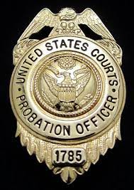

Safe Harbour Coord. contacts Albany Fed Probation Officer
Warrant issued for Rodriguez
He flees to South Carolina
Picked up by US Marshalls

Slide 30
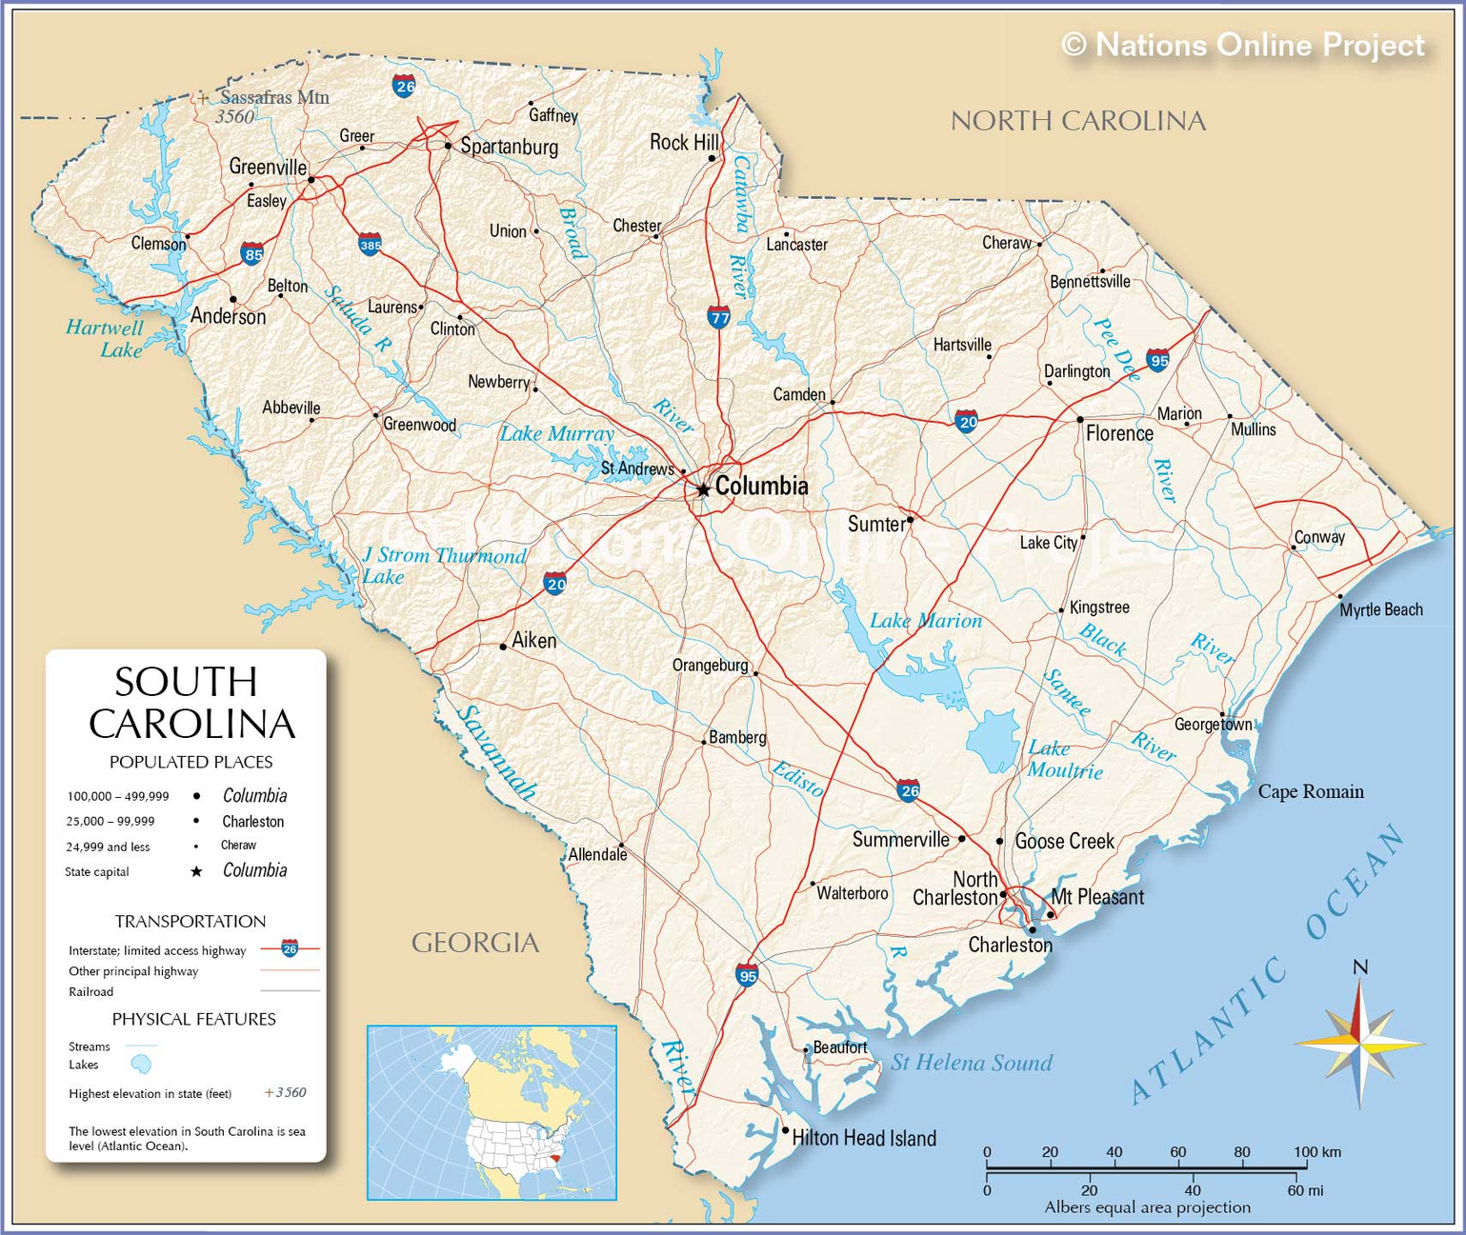

Slide 31
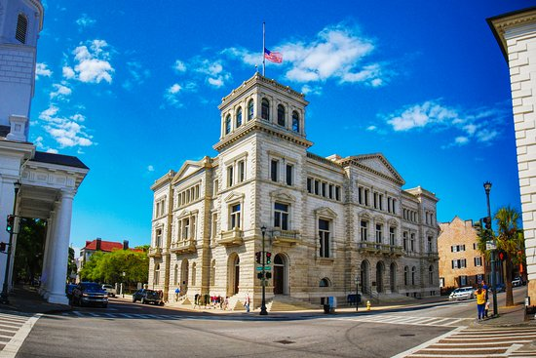
Charleston Federal Courthouse

Slide 32

arrangements made to fly victim to SC to testify
approval from OCFS to send advocate with victim
contact made with local Anti Trafficking organization

Slide 33


48 Hours before hearing, victim begins to panic
Team speaks with federal prosecutor who has concerns
Rodriguez is offered 6 months in lieu of hearing
Upon release returns to Troy NY
Victim flees to FL & then TX

Slide 34
All comes down to relationships in OUR community

Slide 35
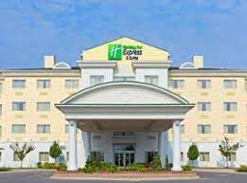
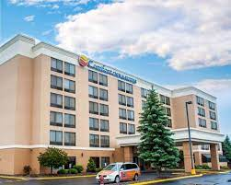
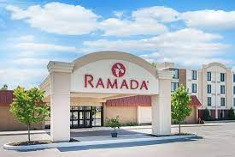

Slide 36
Special Operations

Slide 37
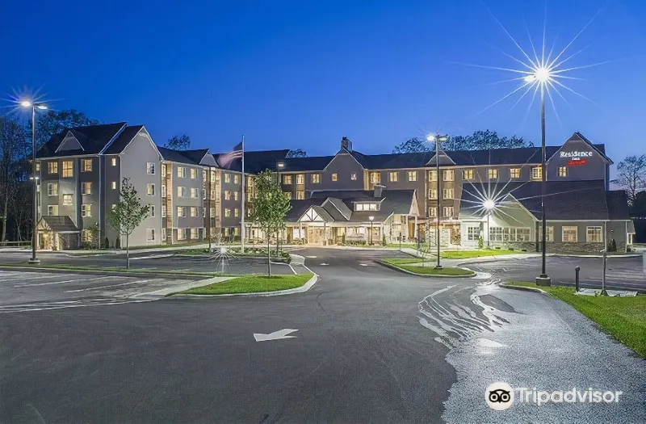
Marriott Residence Inn-Clifton Park NY
Saratoga County-229,863

Slide 38



Goal: Identify Trafficked Youth
Agencies involved
FBI/Agents/Advocates
NYSP/marked units
Saratoga County Sheriff
CAPTAIN Youth Shelter
Safe Harbour Coordinator

Slide 39
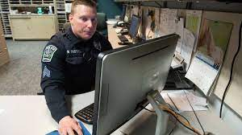
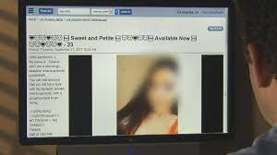
  agents scan ads
  arrange meeting at hotel

Slide 40
outside team monitors movement and
alerts decoy and interior team

Slide 41


proceeds past front desk to elevator
goes to 4th floor decoy room

Slide 42

police identify 15 yr old youth and turns over to SH Team
what if your community does not have "street outreach"

Slide 43

  officers identify 15 year old from Illinois
  not reported missing in any database
  driver in vehicle is paternal aunt

Slide 44
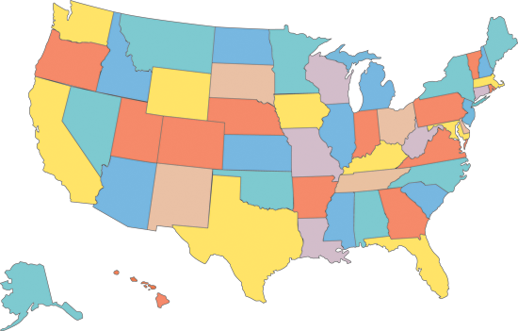
950 Miles

Slide 45
  contact is made with bio mom in Illinois
  arrangements made to fly child back home
  child brought to supervised shelter for night
  shelter staff meets LE advocate at airport

Slide 46
child flown to ORD/met at gate with mom and advocate
follow up services arranged/counseling/medical
however................

Slide 47

intimidation
weapons
trafficking
violence
narcotics

Slide 48


